Slide 1


Hello!

Slide 2

«А journey into the world of the English language»

Slide 3
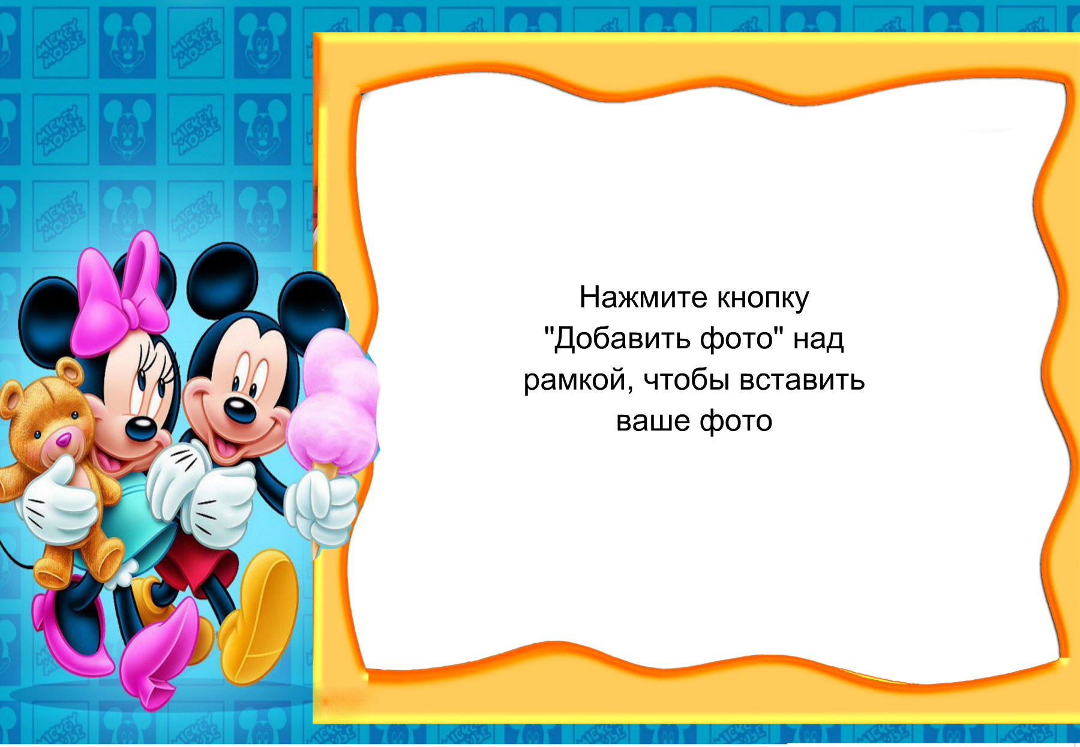

Grammar.

Slide 4
1) Fill in the gaps with am, is, are.
I … fine.
You … from England.
He … very strong.
My sister … busy.
I have a cat. It … fat.
Trees … green in spring.
My brother … good at school.
They … not good friends.

Slide 5


guess the rebus

Slide 6
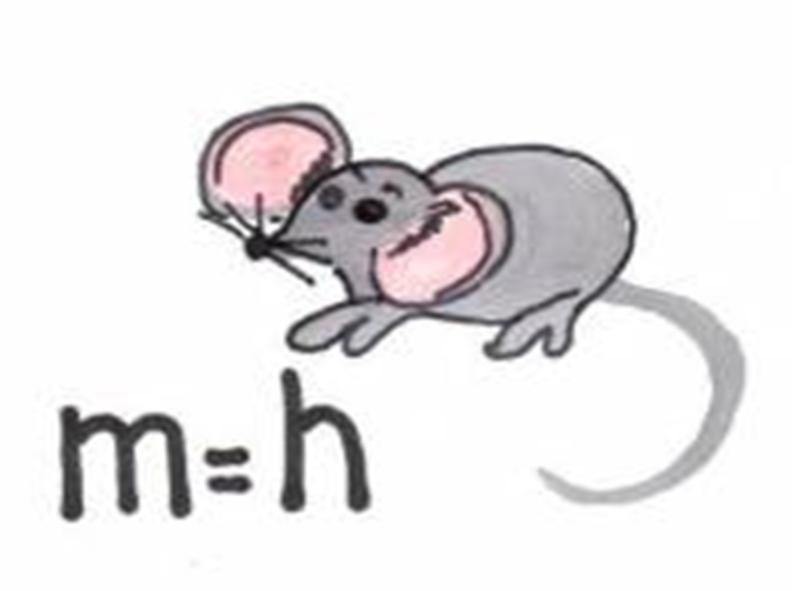

Slide 7


Slide 8


Slide 9


Slide 10


Slide 11
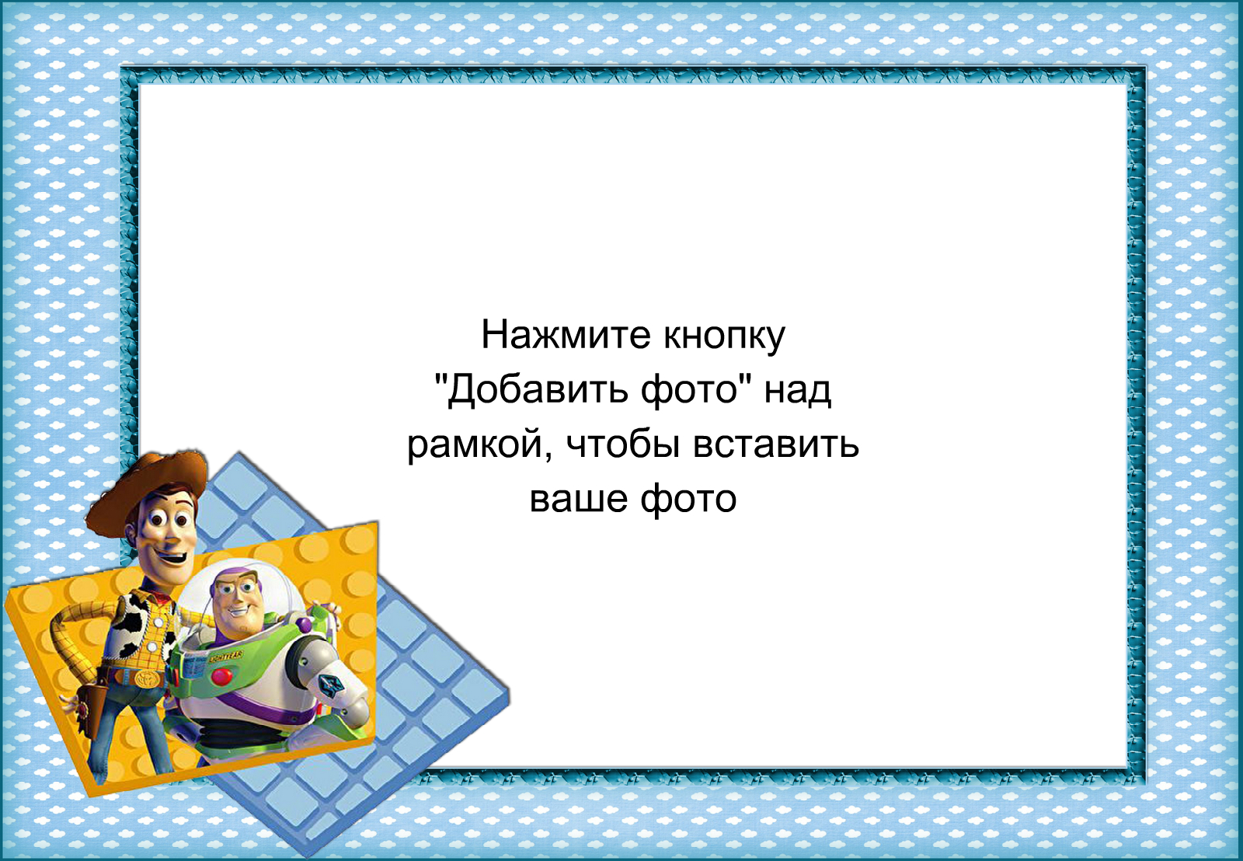

The third part of our competition is called guess the riddles.

Slide 12

It lives in the house.
It likes fish and meat.

Slide 13

It is orange. It is not big. It can run. It is very cunning.

Slide 14

This animal lives at home or in the street. It is a man’s friend.

Slide 15

It is very big and grey.

Slide 16
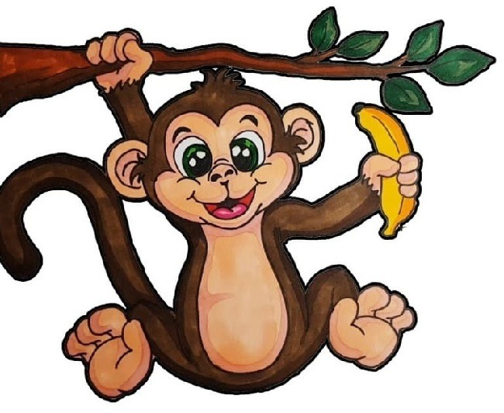
It lives in the forest. It likes bananas.

Slide 17


Lexical

Slide 18
Yes | Bad
Black | White
Small | Short
Long | Light
Good | Goodbye
New | No
Dark | Big
Hello | Old

Slide 19
Yes | Bad
Black | White
Small | Short
Long | Light
Good | Goodbye
New | No
Dark | Big
Hello | Old

Slide 20
Coffee, tea, milk, skate, juice
Sport, cake, egg, sandwich
kitchen, dining room, hall, bathroom, carpet
table, shelf, arm-chair, skirt, sofa.
mum, dad, granny, man, granddad
old, happy, name, cold, good

Slide 21
Coffee, tea, milk, skate, juice
Sport, cake, egg, sandwich
kitchen, dining room, hall, bathroom, carpet
table, shelf, arm-chair, skirt, sofa.
mum, dad, granny, man, granddad
old, happy, name, cold, good

Slide 22

Pick up of ryphm

Slide 23


                По-английски каждый день ручку называем …

Slide 24

Вижу в классе много рук! Книга по-английски …

Slide 25
Дом на улице стоит,
Улицу назвали …

Slide 26


В школе я вчера заснул,
Школа по-английски …

Slide 27
Сел за парту, слышен треск, парта по-английски …

Slide 28
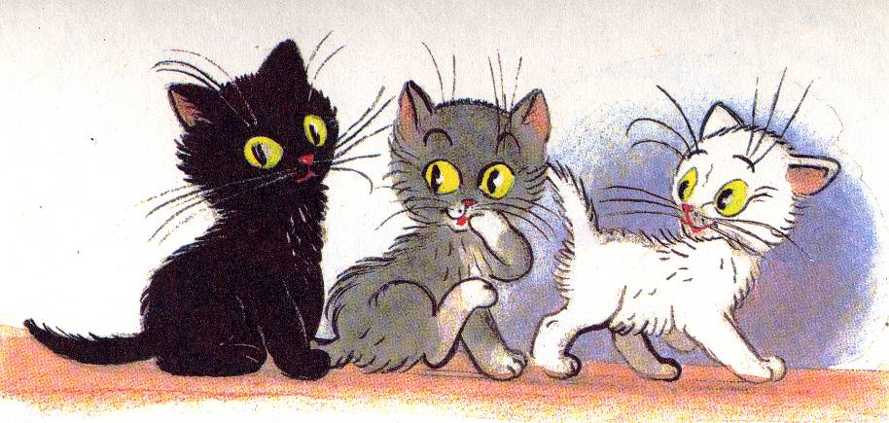
Это вовсе не секрет:
По-английски кошка…

Slide 29
Вы наш город посетите!
Город это будет …

Slide 30

Две изюминки во рту.
По-английски двойка …

Slide 31


Никогда не забывай,
Что пятерка это …

Slide 32

Pick up the flowers

Slide 33


BYE

